Slide 1
44th World Continuous Auditing and Reporting Symposium
Big Data Analytics: utilizing Text Mining to monitor the development of competences in the management accounting profession.
Nicola Castellano
nicola.castellano@unipi.it
Roberto Del Gobbo
roberto.delgobbo@unipi.it
University of Pisa – Department of Economics and Management

Slide 2
Abstract
Purpose (I): to investigate skills/competencies and responsibilities related to the management accounting profession, in order to In order to check for development of competences triggered by Big Data and Business Analytics (BD&A)
Explorative study based on the comparison of job advertisings posted on Linkedin, for positions of management accountants and data analysts. Analysis of differences and similarities.
Purpose (II): preliminary investigations about contingency factors that could impact on the convergence between the two roles (industry, seniority, etc.)
Notes:
Le influenze prodotte dai BD sul controller sono intercettate mediante il confronto con il data analyst. Sul presupposto che la sovrapponibilità tra i due ruoli è indice del fatto che il controller come ruolo è investito da un potenziale cambiamento indotto dai BD/BA.

Slide 3
The management accountant in literature
Research involving the management accountant role can be classified into three main research streams:
Accounting education: Trends in professional requirements (technical, relational, etc.) for the accounting professions are explored with the purpose to develop coherent educational programs (Palmer et al. 2004; Howcroft, 2017).
Macro-perspective: The management accountant role is investigated in association with social, cultural or individual factors (Granlund e Lukka, 1998; Baldvinsdottir et al., 2010).
Micro-perspective: scholars investigate the management accountant within its operating environment giving emphasis to the interactions with operating managers (Byrne e Pierce, 2007) or to the situational factors associated to different levels of involvement in decision making (Zoni e Merchant, 2007).
Notes:
negli anni 70 e 80 il controller era essenzialmente rappresentato come un soggetto caratterizzato da razionalità ed equilibrio;
negli anni 90 tendevano a prevalere preparazione professionale e capacità di azione;
negli anni più recenti emergono in misura più significativa alcuni tratti personali dei soggetti chiamati a ricoprire il ruolo, tra cui l’edonismo.
MICRO: antecedenti e conseguenze, tra i quali l’intensità del capitale investito, il grado di interdipendenza operativa, il livello di competenza finanziaria dei manager di line,
il grado di formalizzazione dei processi di pianificazione strategica e di budgeting
Lucianetti, L. Battista, V. 2015. La manipolazione dei valori di bilancio: pressione del management e tratti personali nell'attività del controller.
Culasso, F. 2017. Controllo di gestione e controller nelle PMI: nessi criticità e prospettive. Controllo di gestione. Vol. 14 (2), pp. 11-20.
Di Fonzo, T., Ferruzzi, C. 2015. Da controller a data business analyst. Controllo di gestione. Vol. 12 (1), pp. 18-24.

Slide 4
The impact of IT on Management Accountants
IT is one of the main factors associated to management accounting innovation (Halbouni, e Nour, 2014) and emplyers ask for the development of suitable competences (Spraakman et al. 2015).
Technological contingency: management accountants working in companies that are implementing ERP have to adjust their competencies (Azan e Bollecker, 2011).
Big Data/Business Analytics (BD/BA) do actually represent the extreme innovation of IT and managers perceive them as much more useful when used in strategic rather than in operating decision making. (Castellano et al., 2017).

Slide 5
Research Questions
1.a Are BD/BA triggering a development in the competencies requested to management accountants?
1.b Are BD/BA triggering a development in the functions covered by management accountants?
2. Do competencies and functions vary according to some situational factors (industry)?
Competencies and functions of management accountants are compared to those of data analysts in order to check for differences and similarities.
Notes:
, tra i quali l’intensità del capitale investito, il grado di interdipendenza operativa, il livello di competenza finanziaria dei manager di line, il grado di formalizzazione dei processi di pianificazione strategica e di budgeting

Slide 6
Data collection
Job advertisings posted on Linkedin (April 2018) for searching for management accounants (392) and Data Analyst (77) in Italy.
Data collected: Recruiting Company (or appointed recruitment company); industry; job description; requested attributes; seniority-level; employment type (full-time/part-time).
Management Accountant |  |  | Data Analyst
Job Advertisings nr.: | 392 |  | Job Advertisings nr.: | 77
Industry (most relevant) | Nr | % | Industry (most relevant) | Nr | %
Electrical & Electronic Manufacturing | 79 | 20% | Information Technology & Services | 22 | 29%
Marketing and advertising | 63 | 16% | Electrical & Electronic Manufacturing | 11 | 14%
Information Technology & Services | 42 | 11% | Marketing and advertising | 9 | 12%
Seniority Level | Nr | % | Seniority Level | Nr | %
Associate | 188 | 48% | Medium level | 33 | 43%
Entry-level | 110 | 28% | Entry-level | 32 | 42%
Mid-Senior level | 48 | 12% | Mid-Senior level | 9 | 12%
Medium level | 33 | 8% | Associate | 0 | 0%
Notes:
I dati raccolti sono essenzialmente di tipo testo, in forma di keyword e descrizioni narrative, entrambi definiti in maniera libera, senza necessariamente ricorrere a formulazioni predefinite, inoltre la compilazione dei vari campi non è obbligatoria, per cui in alcuni casi alcune delle informazioni risultano mancanti.
La maggior parte degli annunci per controller e data analyst sono riconducibili agli stessi tre settori, sebbene con ordini inversi di rilevanza

Slide 7
Elaboration process
Data collected have been processed by using the text mining software KH Coder. The elaboration steps can be structured as follows:
P1 Determination of Occurrences: word count absolute frequencies of.
P2 Concordance Analysis. Definition of significant concepts and analysis of context concordance.
A1 Language-Specificity analysis. Based on cross-tabulation and chi-square analysis. Relevance of differences between concepts related to management accountant and data-analyst
A2 Co-occurrence analysis. Based on Jaccard index. Relevance of similarities between concepts related to management accountant and data-analyst
Notes:
Definizione di concetti verbalmente diversi ma semanticamente simili

Slide 8
Language-Specificity analysis (Competencies)
Management accountant
Economics Degree
Management engineering Degree
Structured companies
Audit companies
Management Control
ERP
Data Analyst
Engineering Degree
Information Sciences Degree
Statistics Degree
Mathematics Degree
Mathematics Statistics Degree
Team working abilities
Relational abilities
Communication abilities
Customer interaction
Information tools
Business intelligence
Big Data
Analytics
Coding languages
QlikView
SAS
Data Visualization
Data Analysis

Slide 9
Language-Specificity analysis (Job functions)
Management Accountant
Cost analysis
Contribution margin analysis
Analysis of variances
Analysis of inventories
Accounting statement
Management control
Reporting
Forecasting
Budgeting
Data Analyst
Data analysis
Performance measurement
Predictive analysis
Simulation analysis
Big data
Analytics
Web analytics
Data mining
Business intelligence
Data visualization
Social media analysis
Text analysis
Customer profiling
CRM
Advertising campaign support
Strategic support
Support new product development

Slide 10
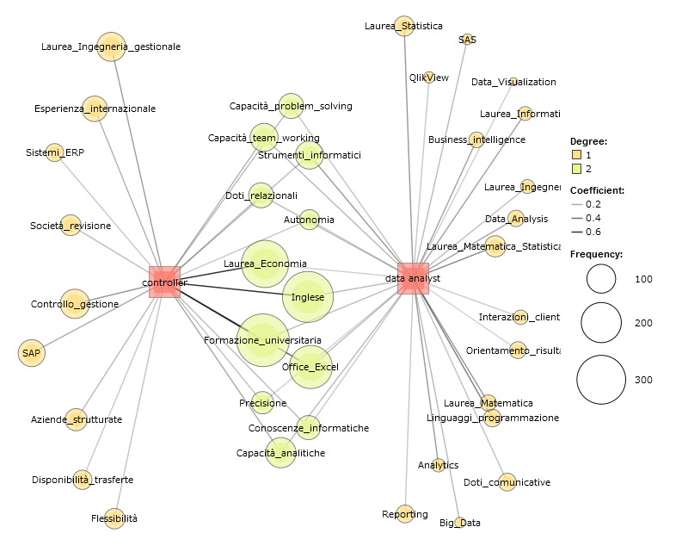
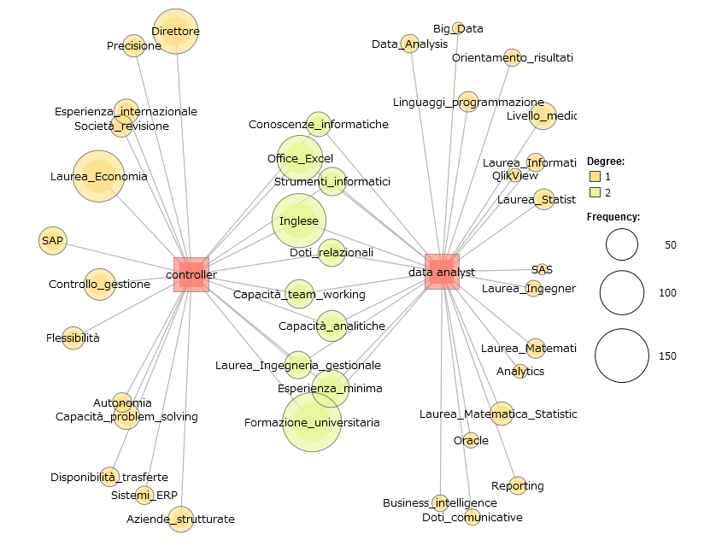
Co-Occurrence Analysis (Competencies)
3S
Notes:
Prime 50 competenze associate a controller e data-analyst
Nei 3 settori il carattere di esperienza minima acquisisce rilevanza

Slide 11
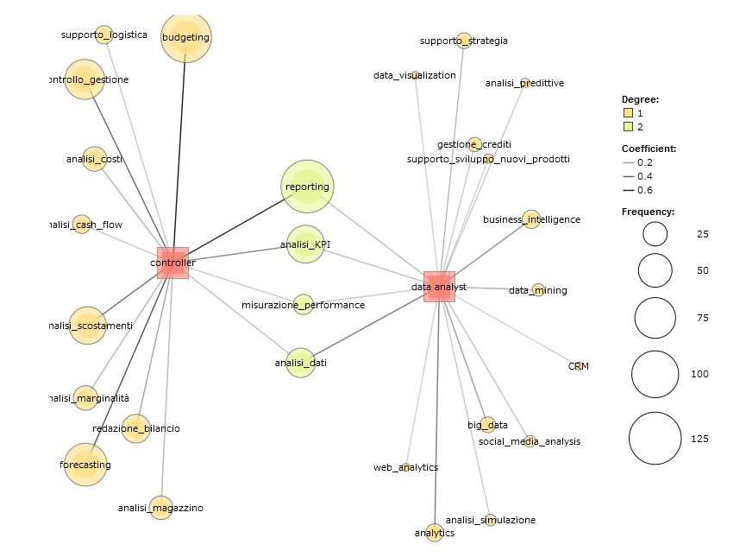
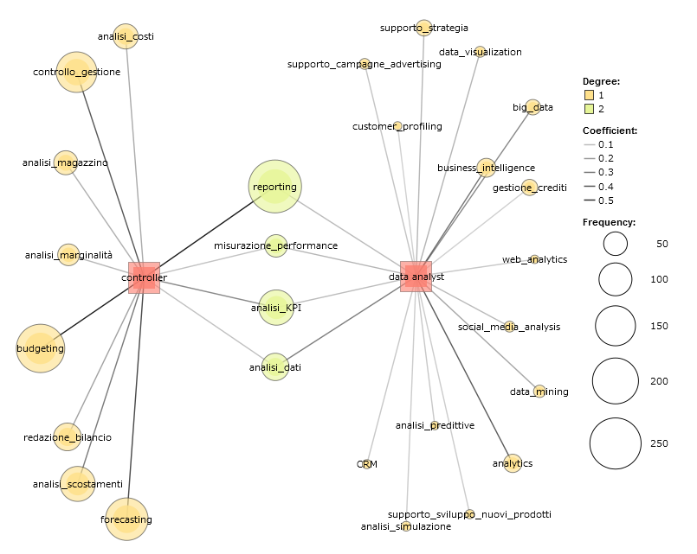
Co-Occurrence Analysis (Job functions)
3S

Slide 12
Conclusions, limitations and future development
Weak signals of convergence between management accountant and data analyst (soft-skills and behavioral issues)
Data analyst and management accountant are assumed to hold specific competencies: data analysis vs management information systems. The distance between the two roles is wider when comparing the job functions).
The differences between the two roles vary considering the industry (particularly for what concern the competencies). Further analysis are deserved on multi-country data.
The convergence between controller and data-analyst may be favoured by developing inter-disciplinary university programs.
The job description may not be accurate in describing what the management accounting/data analyst will be requested to do in the company. The analysis might be complemented through case studies.
The impact of industry is considered only at a very general level. More detailed analysis could shed additional lights.
Additional situational factors might be included in the analysis.

